Slide 1
Analyzing Noise in Trajectory Data
Ravi Shankar
Advisor: Dr. David Koop
Committee Members: Dr. Ming Shao, Dr. Mayoung Sun
Department of Computer and Information Sciences, University of Massachusetts, Dartmouth

Slide 2
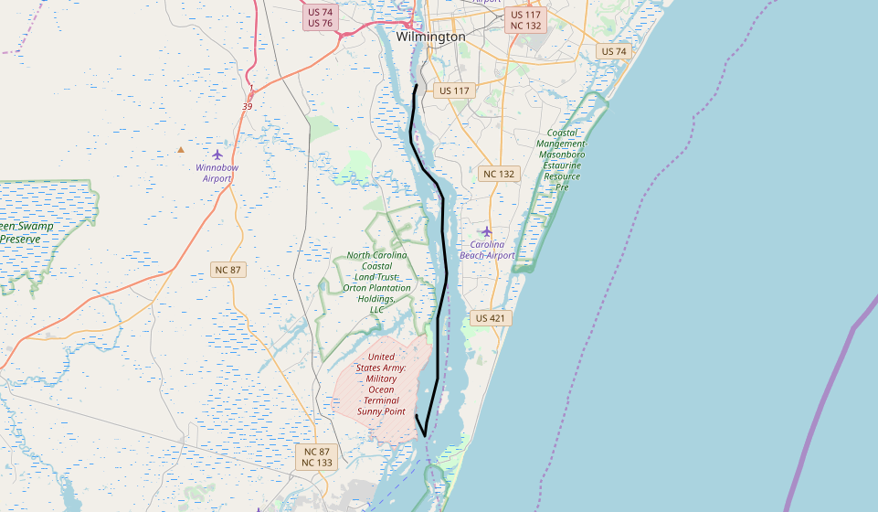
Trajectory

Slide 3
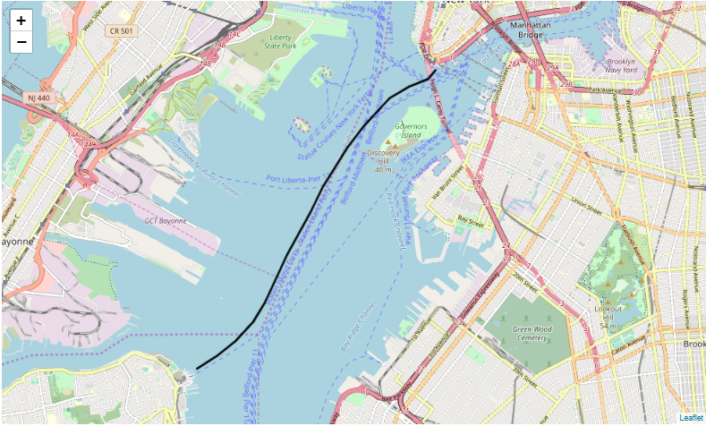
Trajectory

Slide 4
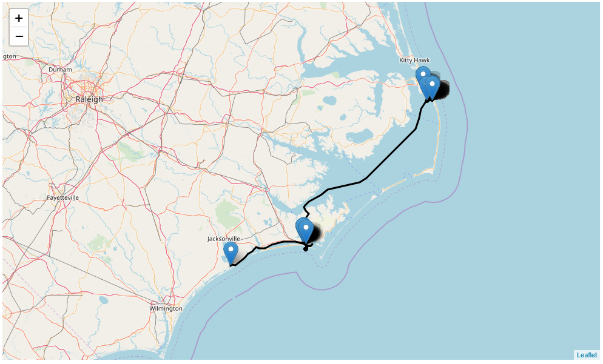
Trajectory

Slide 5
Trajectory Problems

Slide 6
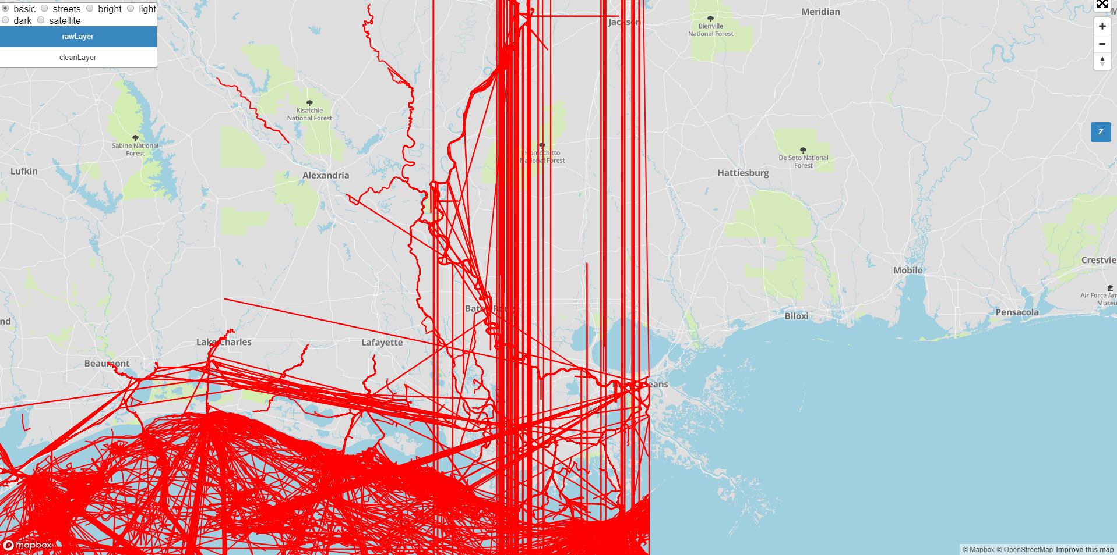
Trajectory Problems:

Slide 7
Introduction
Trajectory data can be collected through different sensors
GPS, phone, IR
Sensors data often contain noise, which needs to be cleaned up
Investigated noise patterns, short trajectories and outliers
Investigated smoothing and segmentation techniques
Proposed the outlier detection technique

Slide 8
Trajectory:
Trajectory is defined as any moving object such as car, person, vessel or any animal, making some path, in the sequence of the timestamps
such as x1t1, x2t2, x3t3, … xntn
where x1 to xn is the series of the moving object and t1 to tn is their
timestamps

Slide 9
Data Set:
Working on AIS Vessels traffic data collected by coastguard service
Dataset contains the multiple broadcast and vessel information
Data is divided into the hierarchy of zones, years and months

Slide 10
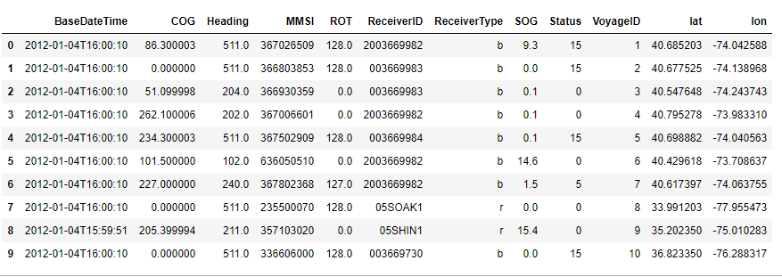
Data Set:

Slide 11
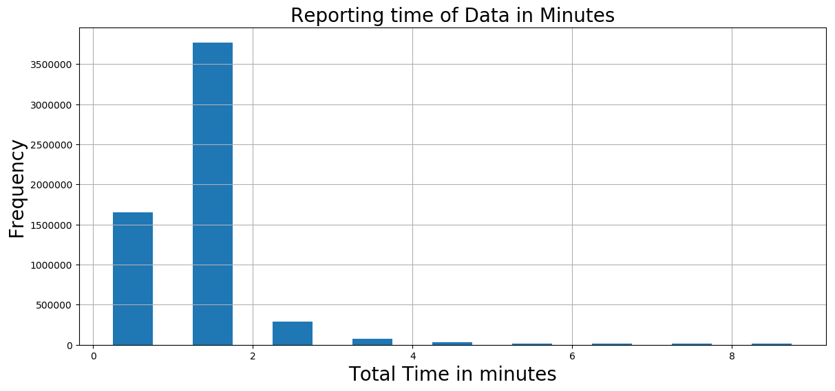
Reporting Time of Data

Slide 12
We calculated the speed with distance and time through given latitude and longitude

Slide 13
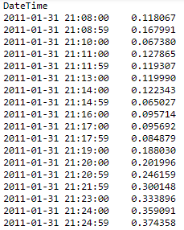
Distance Calculation
Calculated distance through the latitude and longitude

Slide 14
Algorithms:
Sort out all the data based on their given vessel id and their time stamps
Then shift their latitude and longitude points
Calculate the radians between two point(segments) as latitude radian and longitude radian
Subtract the latitude and longitude from the calculated radian points
Apply the Haversine formula
Calculate the distance by multiplying the results with sphere of the earth, in kilometers

Slide 15
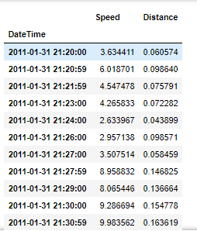
Speed Calculation:
Speed can be calculated through the Distance and DateTime.

Slide 16
Smoothing Speed
Smoothing speed data using rolling mean
Rolling mean is to analyze the series of points in the group and take the mean of the given subset of the series
Why to use the rolling mean?
5 minutes of time frame window and rolling mean
Known as Moving Average

Slide 17
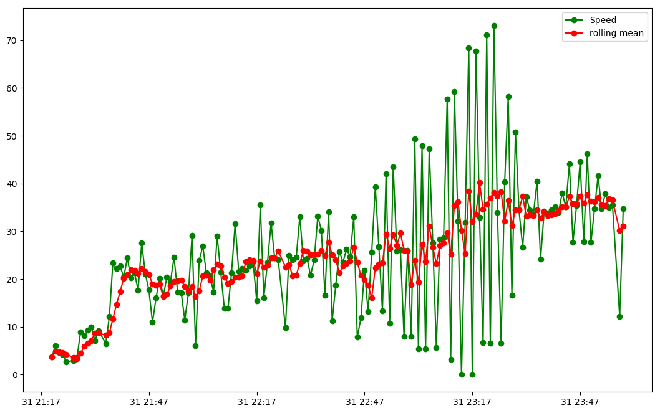
Smoothing Speed

Slide 18
Data Partitioning Techniques:
Vessels Hierarchy (MMSI, Voyages)
Why partitioning trajectories is necessary?
Voyages into Sub Voyages / Trajectories into sub-trajectories
We used two techniques to partitioned the trajectories:
Speed threshold
Counting approach

Slide 19
Stay Points
Stay points / stop points
Calculated through the speed threshold value
Process:
Flag all the points which are below threshold
Shift those points and apply the X-OR function to invert the logic for all true/false value
When the value changes in the truth table from the false to true, that point is being flagged as the valid stay point

Slide 20
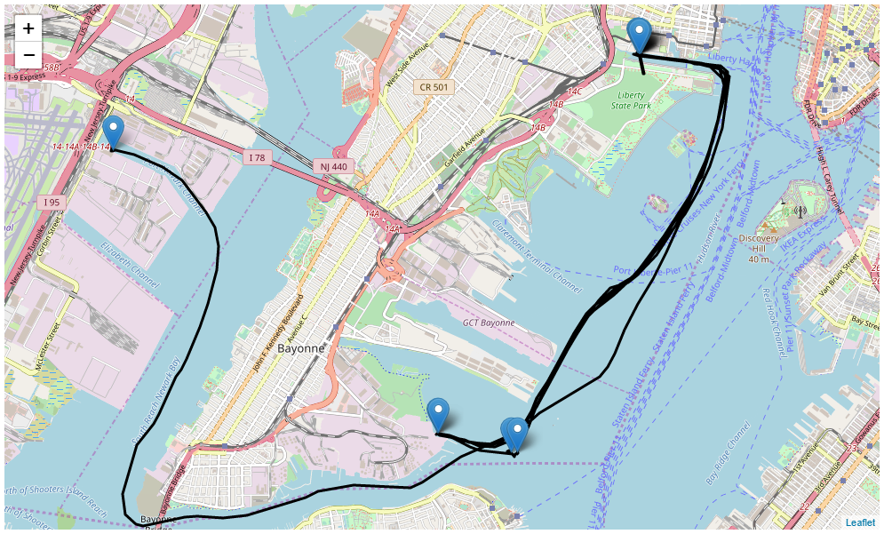

Slide 21
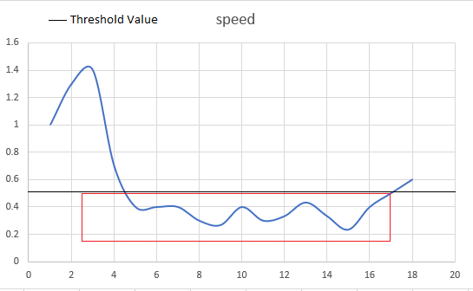
Threshold approach

Slide 22
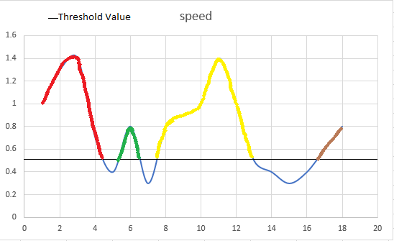
Threshold Approach:

Slide 23
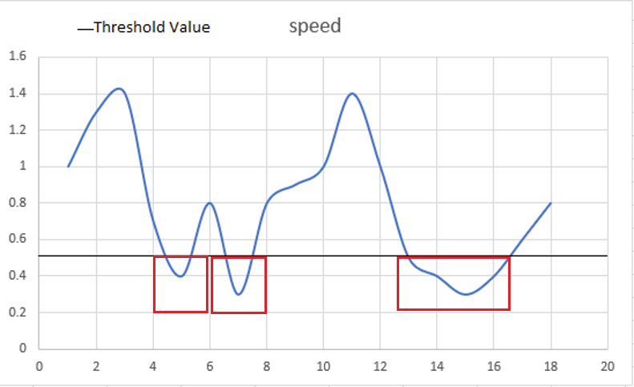
Counting approach

Slide 24
Why counting approach?
Because if the points are keep changing at the threshold value then we can loose a valid trajectory data.
Threshold Technique partitioned it into 3 to 4 sub-trajectories, where as counting technique counting technique considered it just single trajectory.

Slide 25
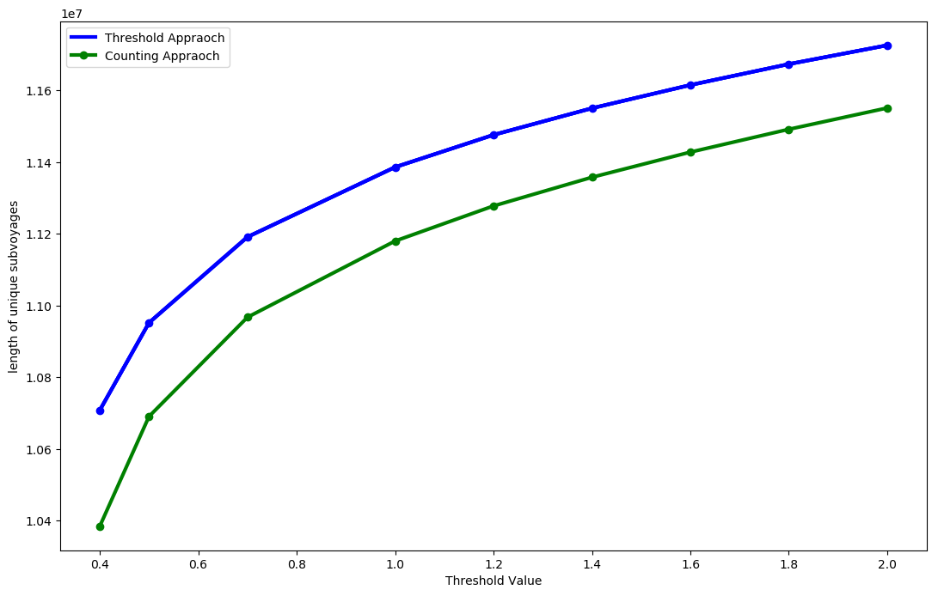
Total Unique Trajectories breakdown with Threshold and Counting approach

Slide 26
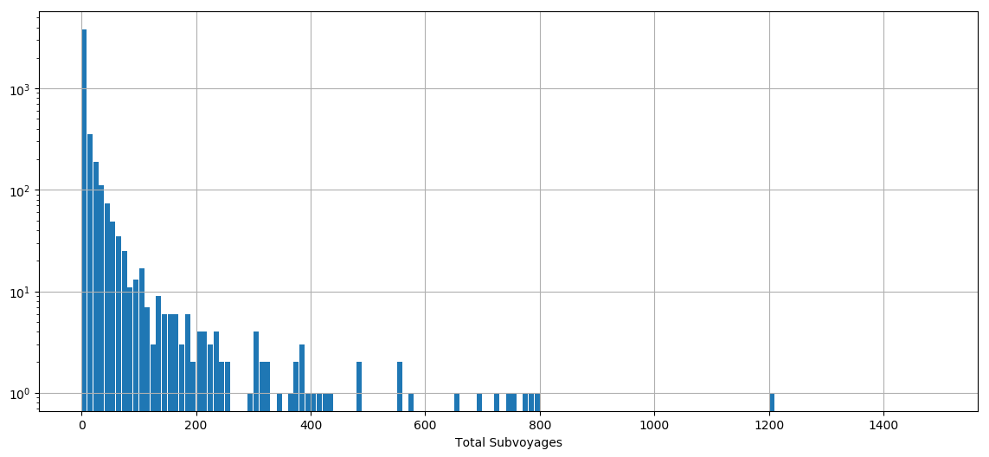
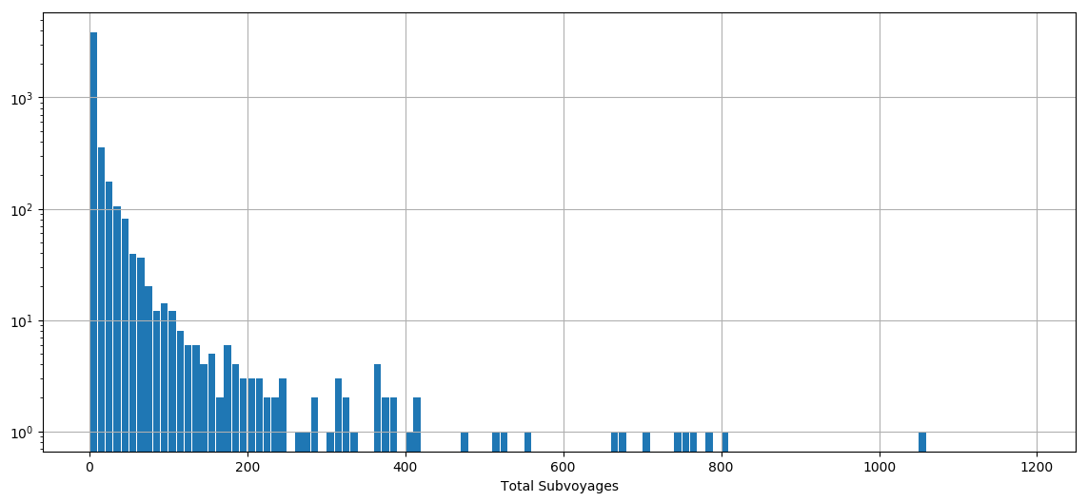
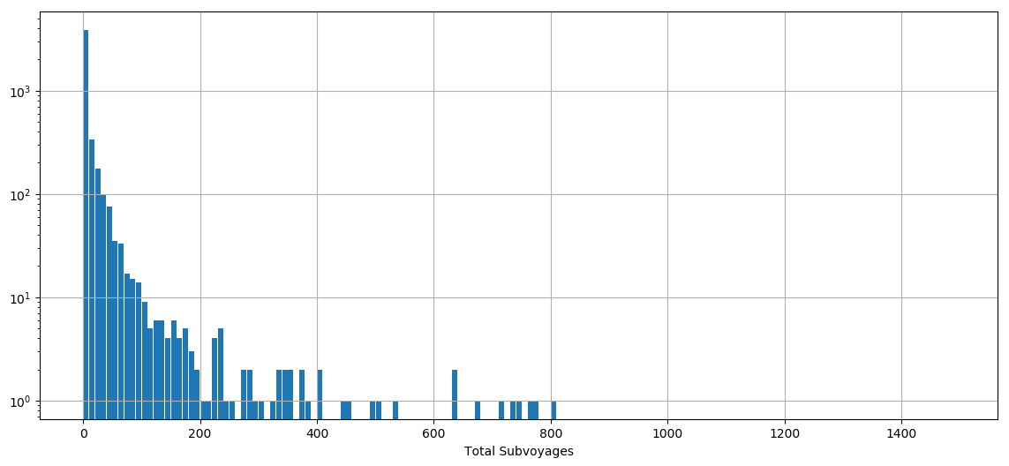
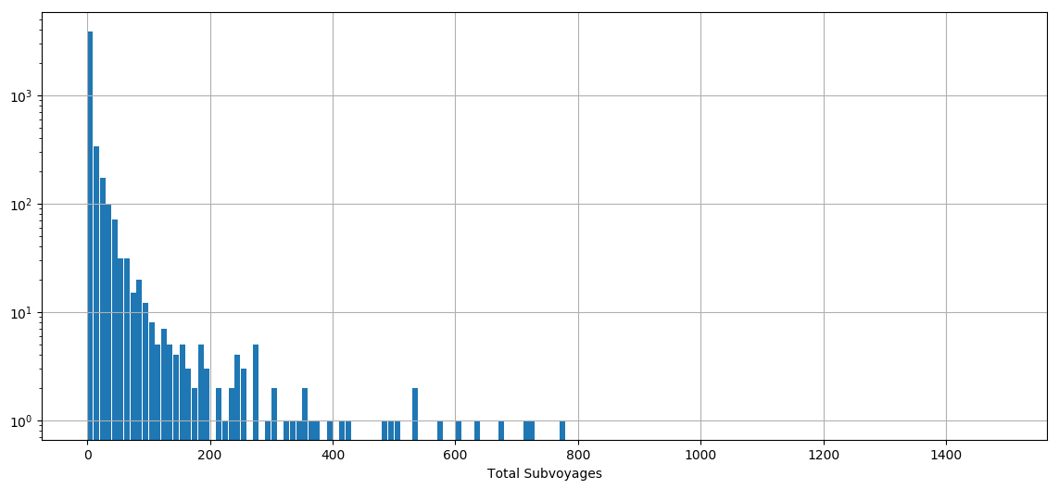
Threshold distribution
Threshold 0.4
Threshold 0.5
Threshold 0.7
Threshold 1.0

Slide 27
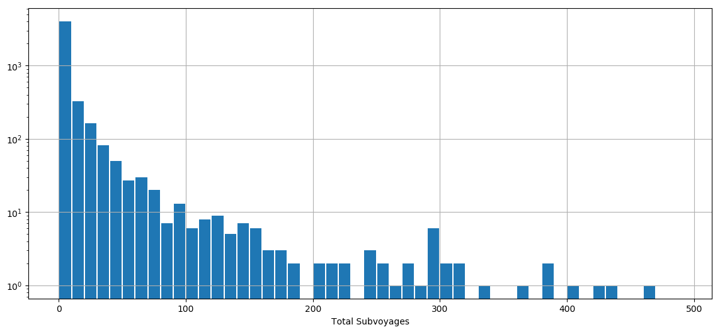
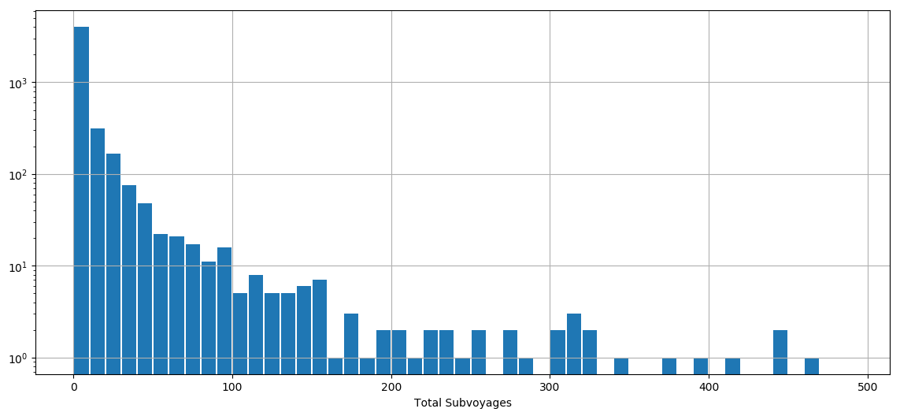
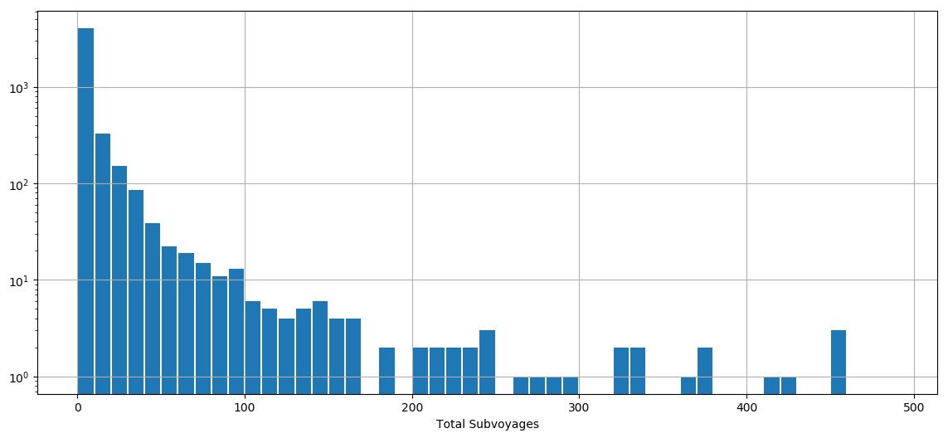
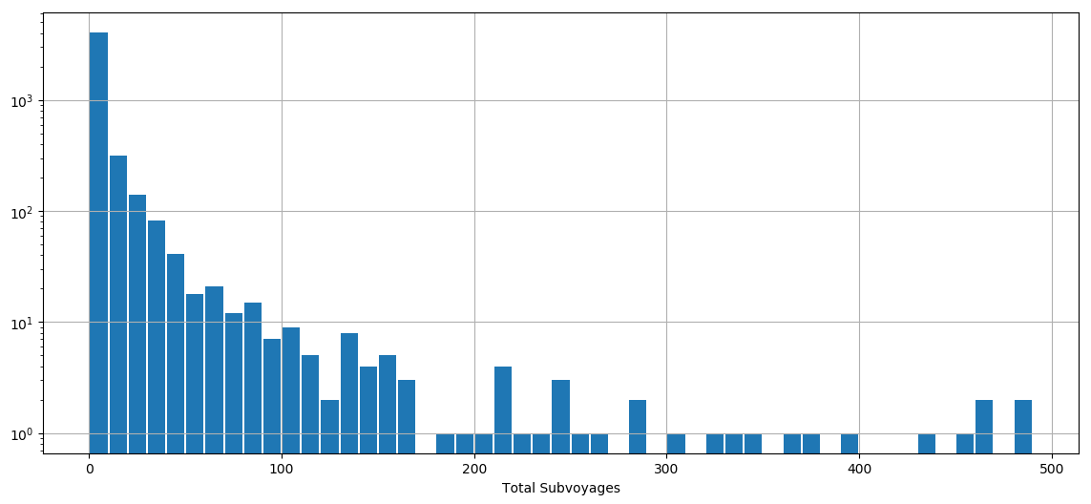
Counting approach distribution
Threshold 0.4
Threshold 0.5
Threshold 0.7
Threshold 1.0

Slide 28
Data Cleaning
GPS data is never accurate
To ensure the data is correct and remove all inaccurate information
To improve the quality of data
We used statistical and mathematical formulas to detect these noise points

Slide 29
Missing Data
Partitioning data based on Time
Missing data for hours or days
Challenges because of missing data

Slide 30
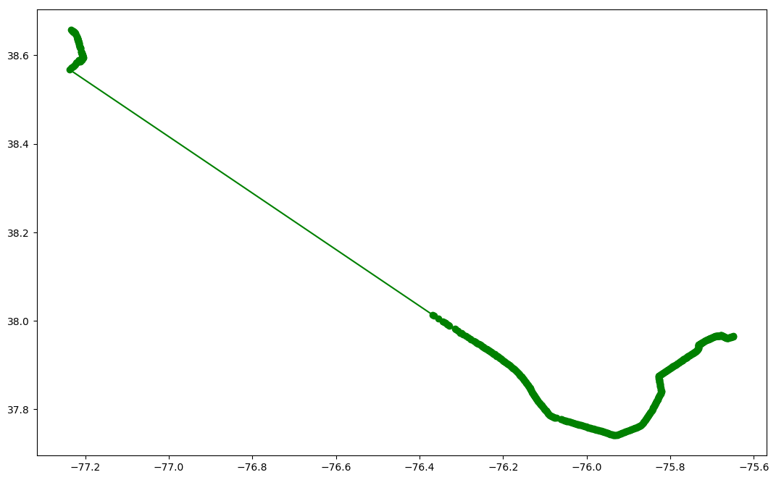
Missing Data

Slide 31
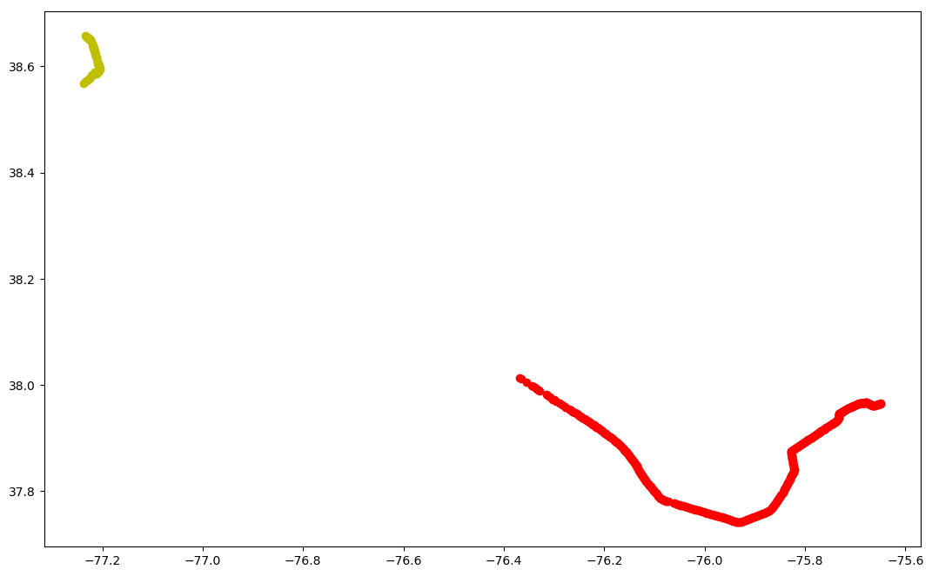
Missing Data

Slide 32
Removing Noise with Distance and Speed - Validations
Part of data cleaning
Used speed and distance validations to find out the bad sub trajectories
Distance and speed are greater than regular values
These bad points are either are a big trajectories on earth, or some data are just random points, just some ambiguous trajectories

Slide 33
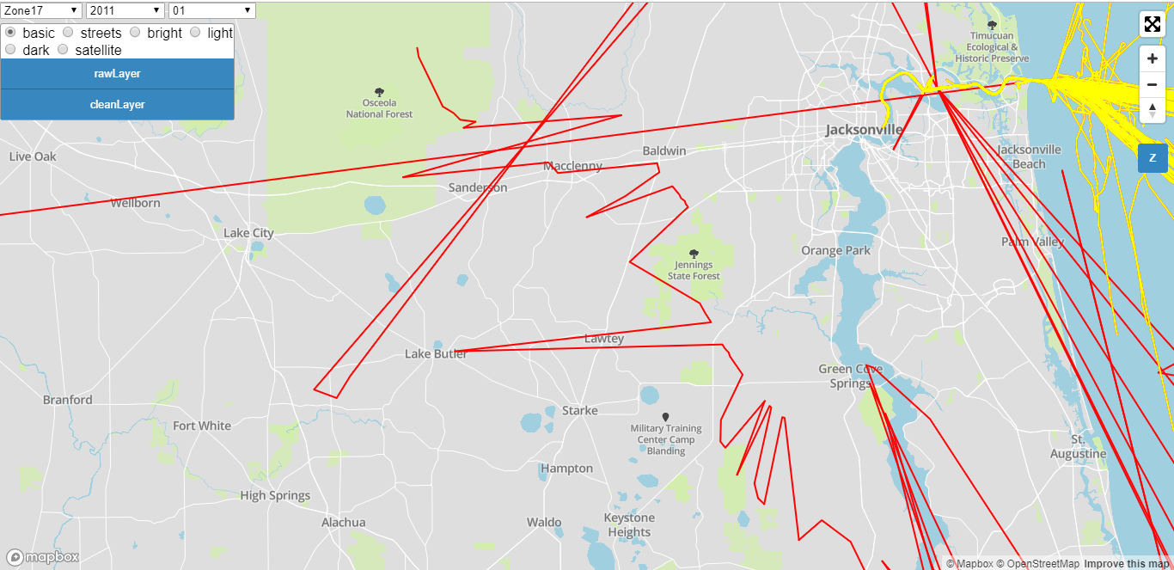
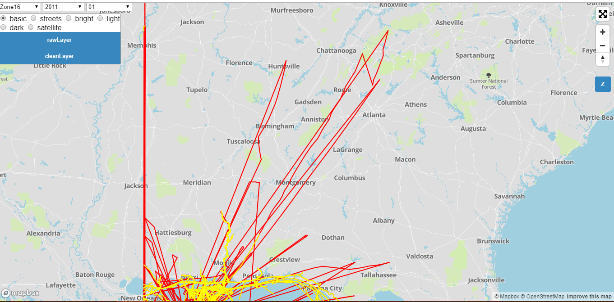
Removing Noise with Distance and Speed - Validations

Slide 34
Noise Patterns
Several kind of noise patterns detected
Small distance covered in a lot of time duration
Either stayed on place or moved very slowly
Short sub trajectories
Used several algorithms

Slide 35
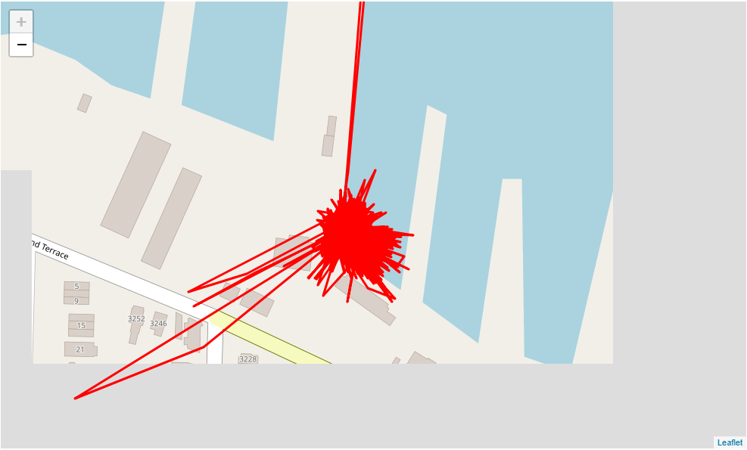
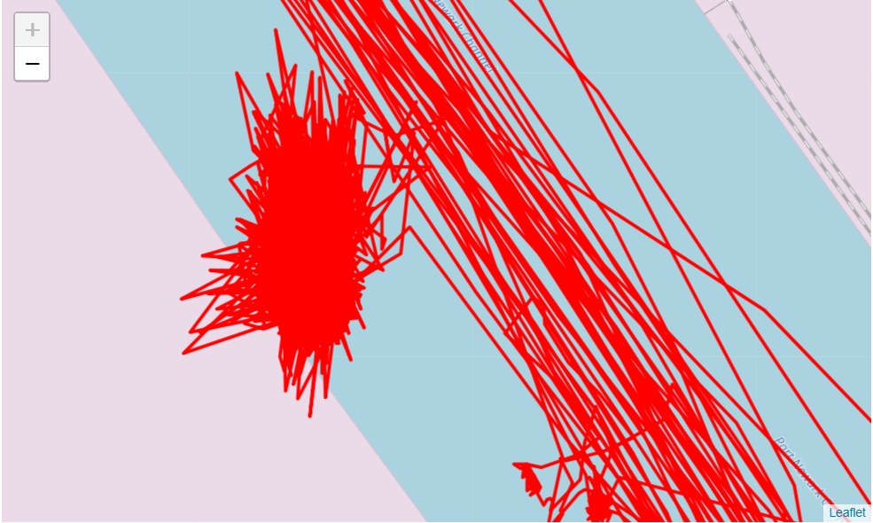
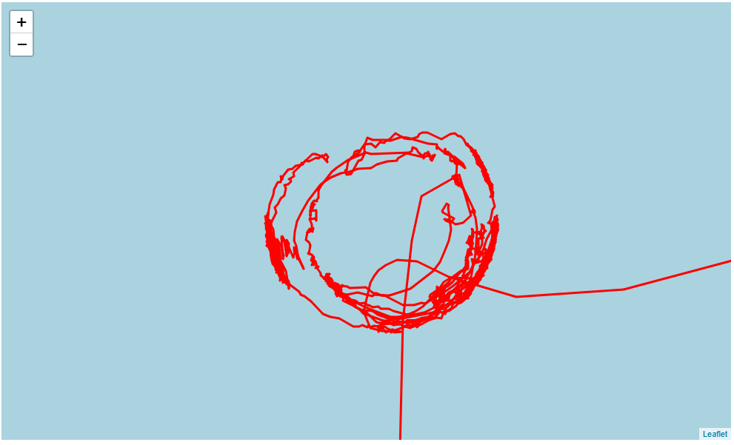
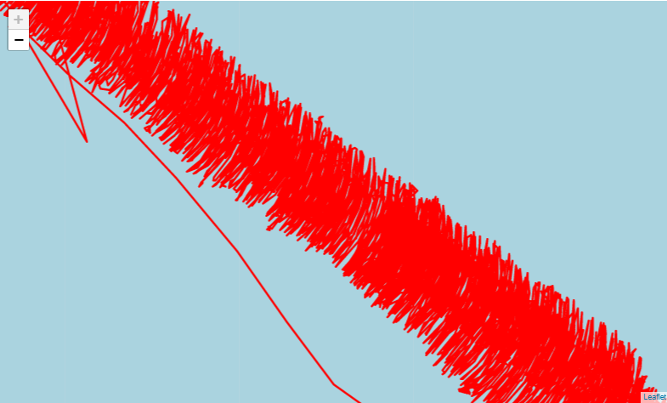
Example of Noise Patterns

Slide 36
Bounding Box
What is Bounding Box
Separated the noise patterns or short sub-trajectories
Bounding box gave the useful results.
Process:
Group all the data based on the sub trajectories
Calculate the maximum and minimum location information through aggregation and grouping
Calculate the distance through the distance formula.

Slide 37
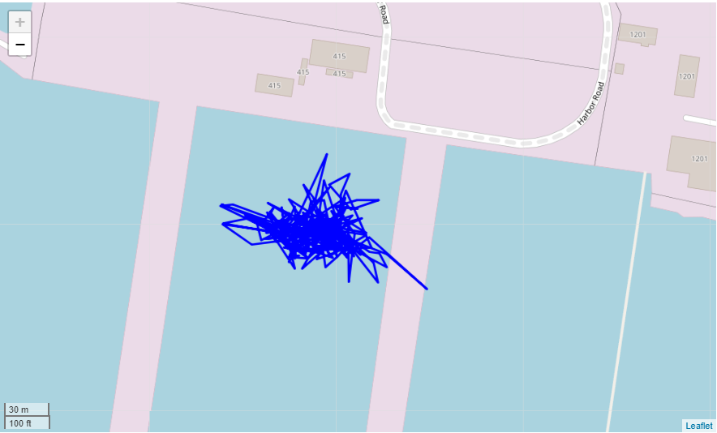
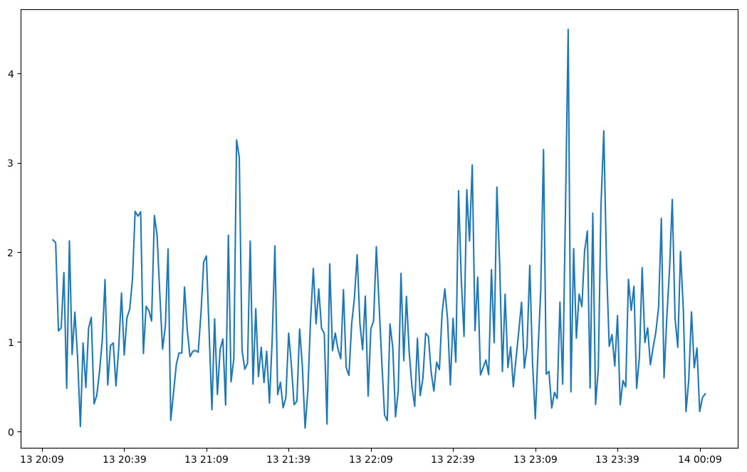
Bounding Box (Example)

Slide 38
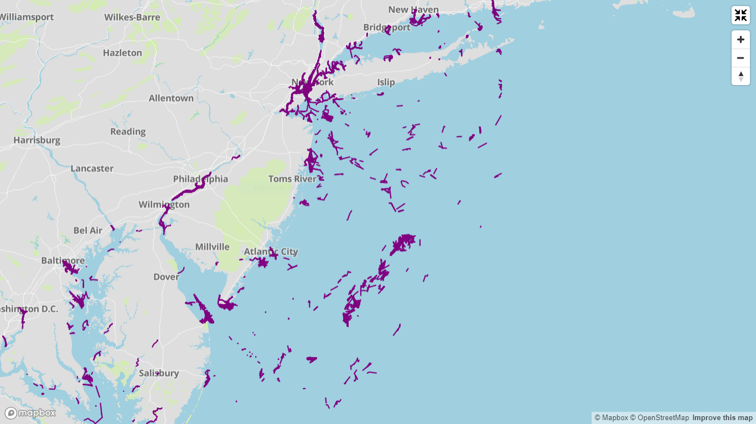
Bounding Box

Slide 39
Bounding Box

Slide 40
Bounding Box – Short sub trajectories

Slide 41
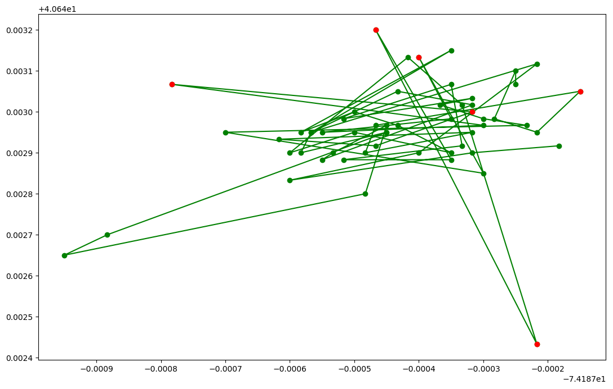
Why we separated these with bounding box?

Slide 42
Kalman Filter
Kalman filter is introduced by Rudolf E. Kalman, used to predict the uncertain information about the data depends on the dynamic of the system
Used to detect the distortion and noise in the data depending on the frequency of its power of estimation
Kalman filter takes the measurement inputs in the timeseries data to calculate and predict statistical noise points, measure the inaccuracy, and results in the estimation and accuracy of those false points
We used Kalman filter to reduce these noise and patterns in the data.
First It takes the measurement input as the location information
Second step it takes the observation matrix over one time stamp as an identity matrix
And then based on this it normalize the data, and filters the noise

Slide 43
Error in the trajectory

Slide 44
Kalman Filter
Results Kalman filter were able to locate the error, and fixed by estimating the new points, but it was not so accurate

Slide 45
Kalman Filter

Slide 46
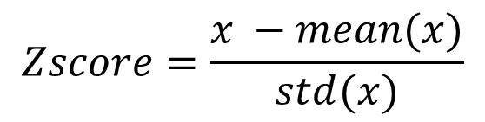
Z-Score
What is Z-Score?
Calculate the probability of the score in the normal distributions
$$Zscore=\frac{x −mean(x)}{std(x)}$$
Z-Score can be calculated through this equation where x represents the series of values.
We used Z-Score in three different ways
Chunks of every 30 to 60 minutes of data
Z-Score with perpendicular distance (point to the line distance)
Z-Score with Speed

Slide 47
Z-Score
First Z-Score applied with the small chunks of data with the time frame window.
It was detecting only few large distance noise points, but missing a lot of noise in the trajectory data
Algorithm
Group all data based on the sub trajectories
Divide the data at every 30 and 50 minutes of chunks
Calculate the mean and standard deviation of those chunks
And then calculate the Z-Score through the given equation

Slide 48
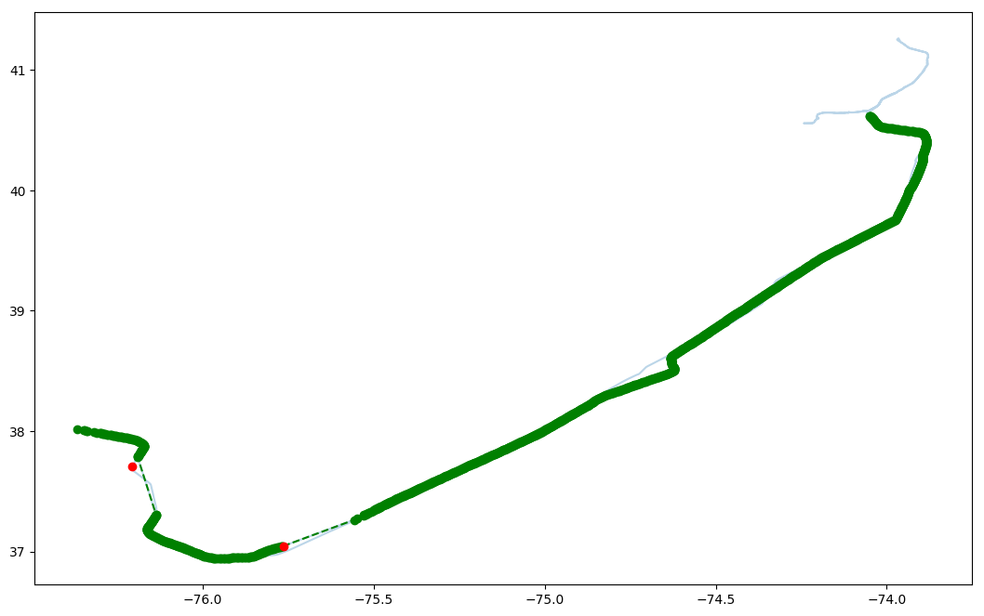
Z-Score Example

Slide 49
Centered Z-Score
Centered Z-Score is used to find the outliers in the data.
Algorithm
Apply rolling technique at every 60 minutes of data with using left closed edge
Reverse the chunk based on date and time
Apply the rolling sum
Sort the data back with the date and time
Count all the values in the 60 minutes of time frame window
Apply rolling technique at every 60 minutes of data with using right closed edge
Count all the values in the 60 minutes of time frame window

Slide 50
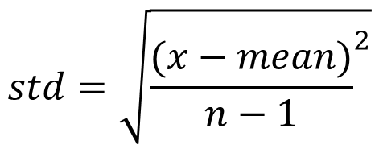
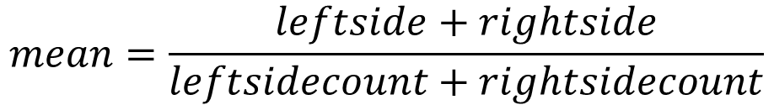
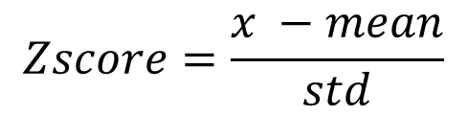
Centered Z-Score
Add both the right and left side of the data
Add the total count of the left and right side of the data
Calculate the mean and standard deviation by grouping them on their sub trajectories
Use the z-score formula by grouping them on their sub trajectories
Equation:
$$mean=\frac{leftside+rightside}{leftsidecount+rightsidecount}$$
$$std=\sqrt{{\frac{(x−mean)}{n−1}}^{2}}$$
$$Zscore=\frac{x −mean}{std}$$

Slide 51
Z-Score on Speed
Used Z-Score with speed on different time threshold value
Speed detected almost all the noise points at the lowest threshold adds up the large gaps and other data
Used different time frame windows
30 minute window is the short time frame window

Slide 52
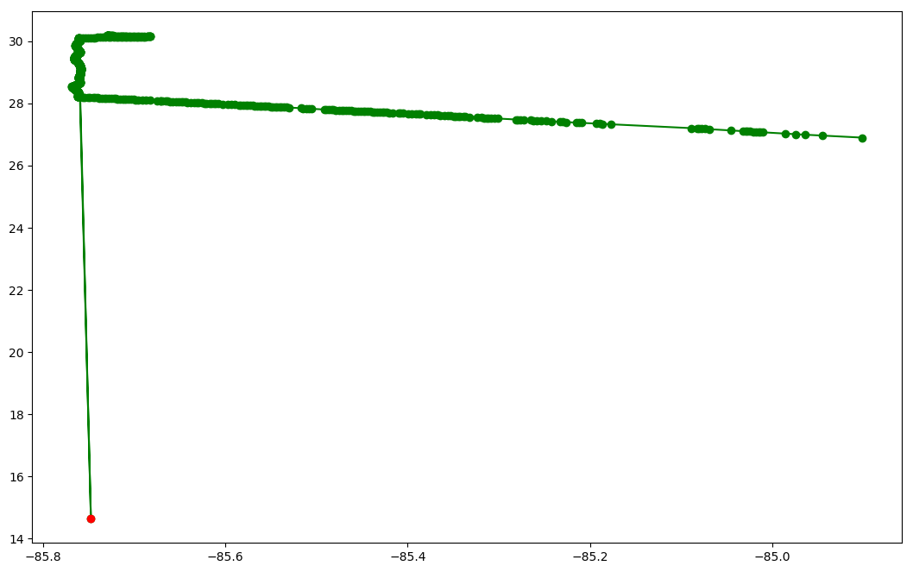
Z-Score on Speed

Slide 53
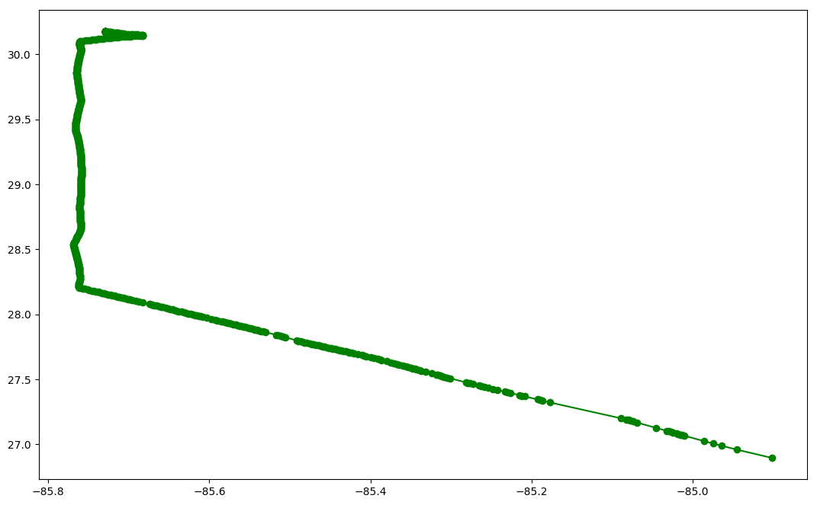
Z-Score on Speed

Slide 54
Z-Score on Speed

Slide 55
Z-Score on Speed

Slide 56
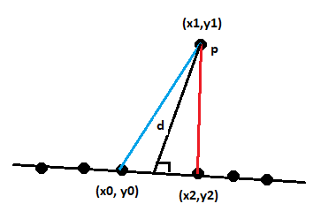
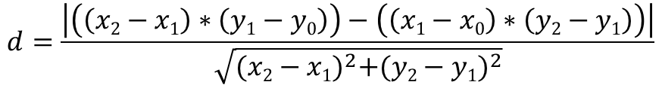
Perpendicular distance
Point to the line distance describes the smallest distance from the point to the line
It is calculated through applying the line equation and to find the distance from the point to the line
Example of the perpendicular distance from the point to the line
Equation:
$$d=\frac{\left|\left(\left(x2−x1\right)∗\left(y1−y0\right)\right)−\left(\left(x1−x0\right)∗\left(y2−y1\right)\right)\right|}{\sqrt{{(x2−x1)}^{2}+{(y2−y1)}^{2}}}$$

Slide 57
Z-Score on Perpendicular distance
We used the Z-Score and perpendicular distance to catch outliers
Used the different time frame windows and parameters for z-score
Working very well to catch these blip points or sudden jumps in the data
Missing out few large gaps
Detecting small gaps in the data

Slide 58
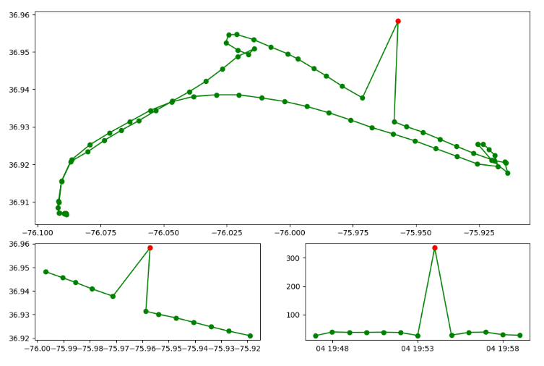
Z-Score on Perpendicular distance

Slide 59
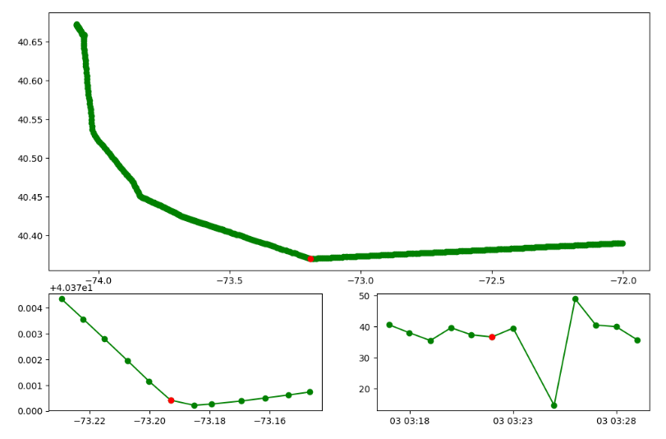
Z-Score on Perpendicular distance

Slide 60
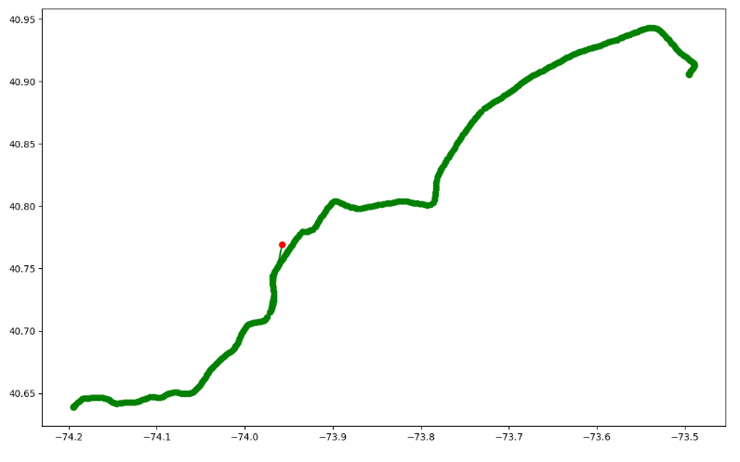
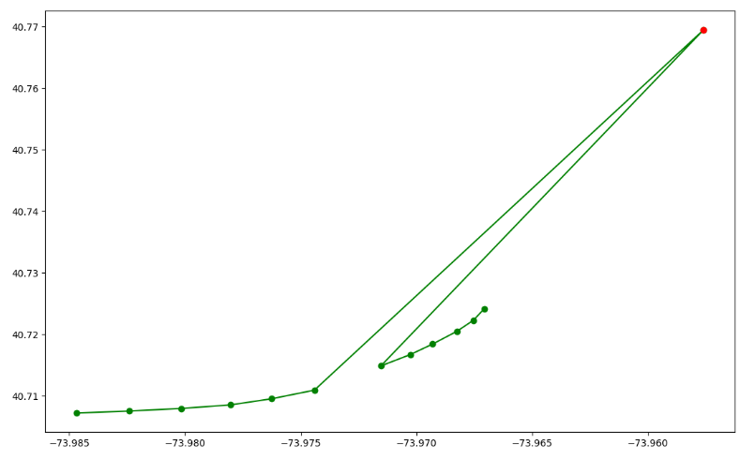
Z-Score on Perpendicular distance

Slide 61
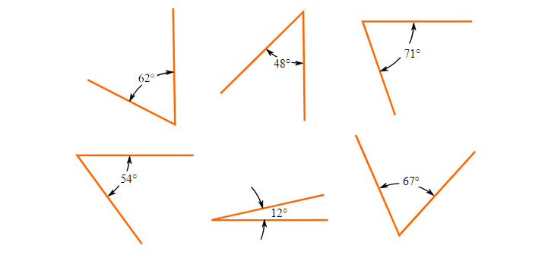
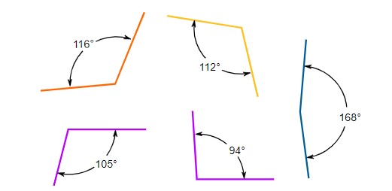
Angle with Z-Score on Speed
Angle technique is used to find out the actual noise point, which is flagged with the Z-Score and Speed
Acute and Obtuse angle are used to find out the Noise, Corner and Gaps
Calculated angle with the latitude and longitude points
Acute angles
Obtuse angles
Equation:
$$x=R.cosθ.cosλ, y=R.cosθ.cosλ, z=R.sinθ$$

Slide 62
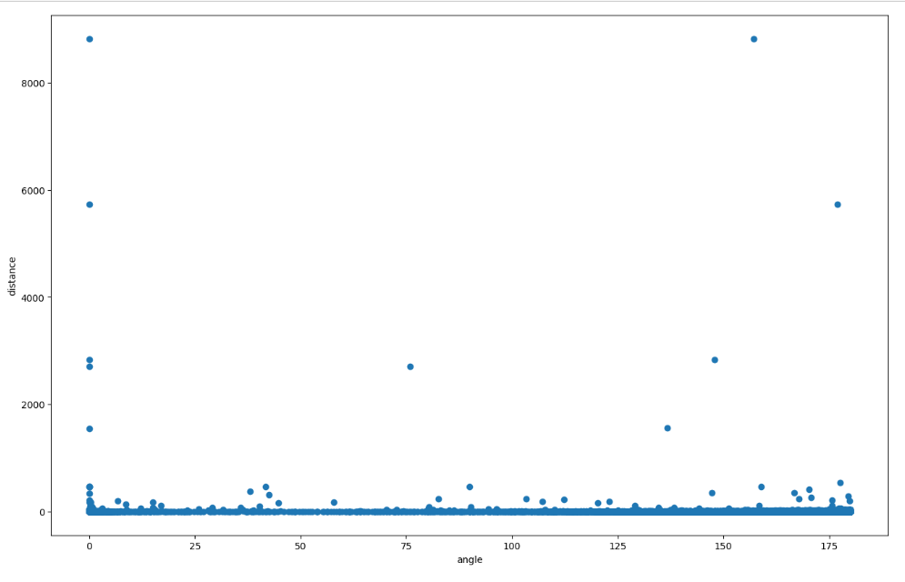
Angle with Z-Score on Speed
We use to show the distribution with the angle and distance carried out with the distance and Z-Score

Slide 63

Angle with Z-Score on Speed

Slide 64

Angle with Z-Score on Speed
This figure shows the how angle justified the actual noise point which is flagged as red and all other yellow points discarded

Slide 65

Angle with Z-Score on Speed
The red trajectory shows the error and blue trajectory shows that error is removed from the trajectory

Slide 66
Detected points – Examples

Slide 67
Detected points – Examples

Slide 68
Detected points – Examples

Slide 69
Experimental results
There is a lot of AIS vessels traffic data is available at coastguard.gov
Data is divided into zones, year and months hierarchy
We applied these techniques and algorithms of several zones, years and months

Slide 70

Experimental results
There is a lot of AIS vessels traffic data is available at coastguard.gov
Data is divided into zones, year and months hierarchy
We applied these techniques and algorithms of several zones, years and months

Slide 71


Slide 72

Short sub-trajectories

Slide 73

Trajectories contain noise and cleaned

Slide 74

Amount of noise in the data

Slide 75
Demo
Trajectories raw and clean data
Bounding box data

Slide 76
Conclusion:
We presented algorithms for data smoothing, segmentation and cleaning it.
It is used for the various applications;
Such as clustering the data to find the routes
Can be helpful to improve the quality of the sensors.

Slide 77
Questions???

Slide 78
Thank You

